Slide 1

Parking Space Detection System
An intelligent solution designed to optimize parking management using real-time computer vision.

Slide 2
System Overview & Architecture
Main Modules
System Details
main.py: Entry point, GUI and CLI
Supports webcam, screen capture, and static images.
picker.py: Sets parking spaces with GUI
Advanced computer vision algorithms enable accurate space detection.
detector.py: Handles detection and monitoring

Slide 3
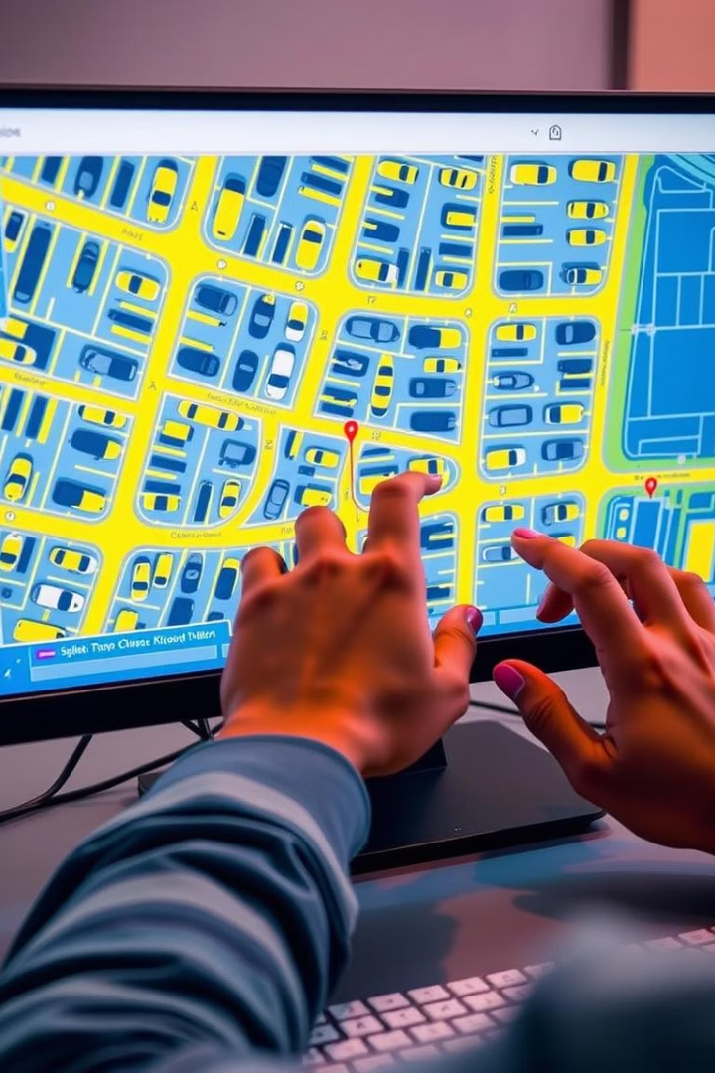
Key Features & Workflow
Setup Mode
Mark four corners of each parking space interactively.
Save and reuse configurations for convenience.
Detection Mode
Real-time parking space status with color codes.
Desktop alerts notify availability instantly.
Adjustable sensitivity and detailed analysis views.

Slide 4
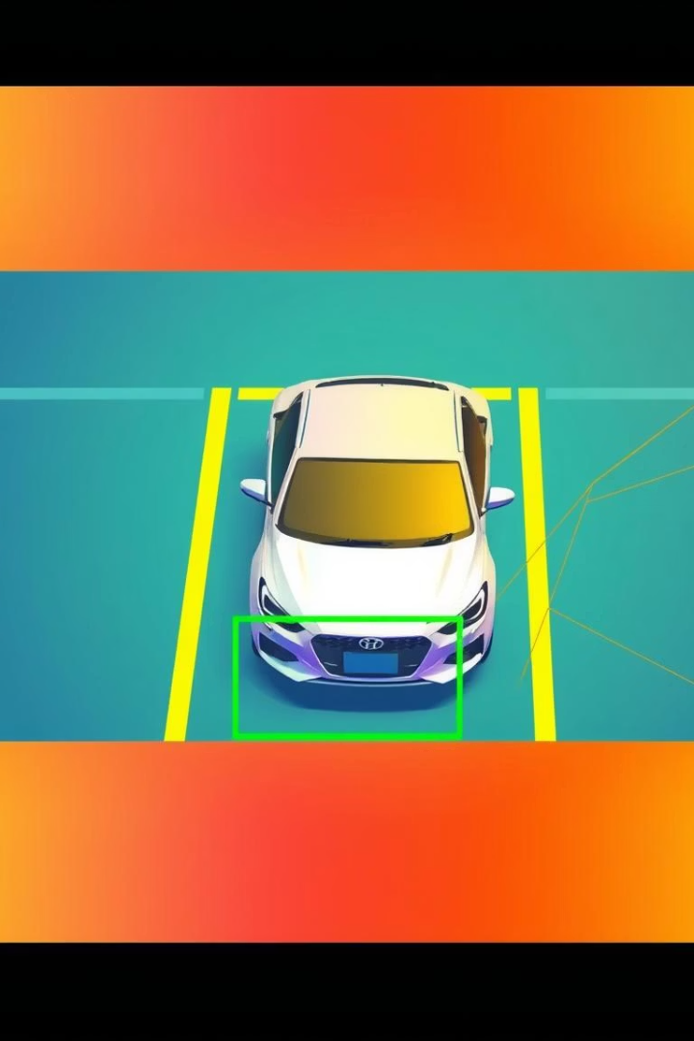
Technical Approach
Detection Techniques
Description
Background subtraction
Identify moving objects in the scene
HSV color analysis
Assess color variations to detect cars
Shadow and edge detection
Analyze shadow patterns and edge density
Weighted scoring
Combine scores for accurate spot classification

Slide 5
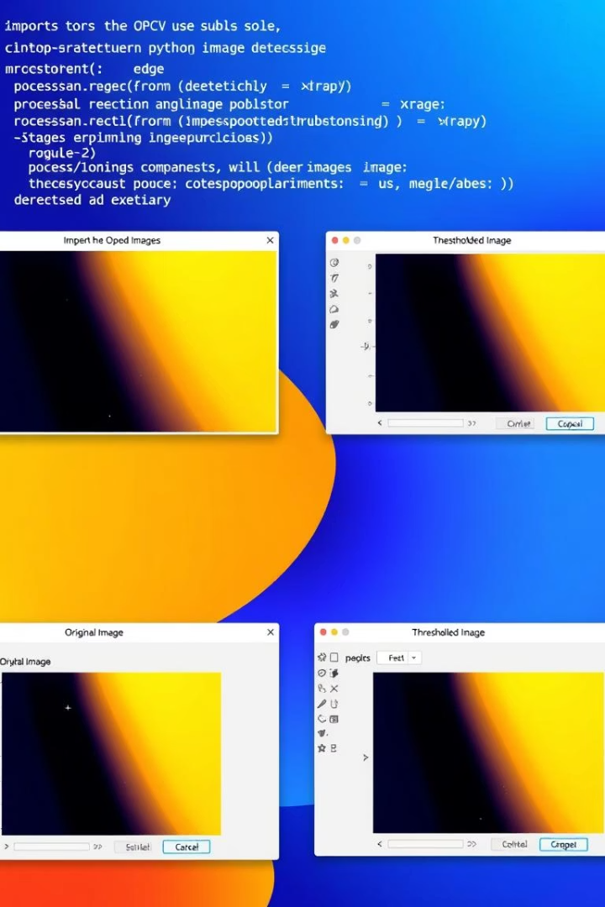
Implementation & Technology Stack
Languages & Libraries
Auxiliary Tools
Python, OpenCV for vision
YAML for config
NumPy for numeric operations
PIL/Pillow for images
Plyer for desktop alerts
Tkinter for UI
Functional Highlights
Auto scaling for resolutions
Persistent space configurations

Slide 6
Future Enhancements
Cloud platform for remote parking monitoring
Automatic lane and car detection with AI implementation
Automatic license plate detection

Slide 7
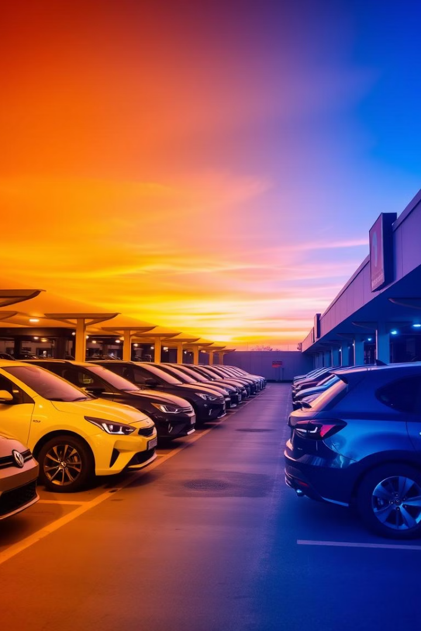
Thank You
Parking Space Detection System delivers efficient, intelligent parking management solutions for today's urban challenges.

